Slide 1
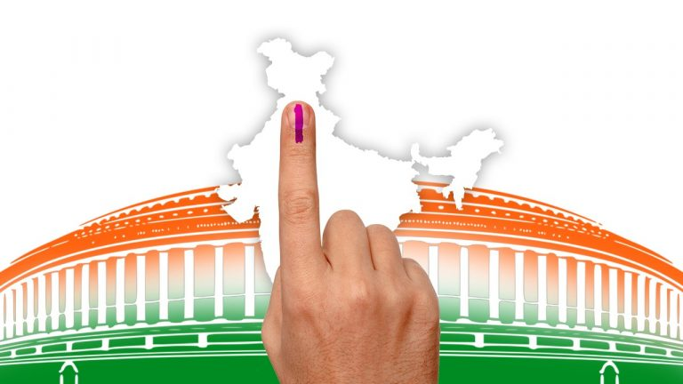
INDIA GENERAL ELECTIONS RESULT ANALYSIS 2024

Slide 2

INTRODUCTION
Elections are the cornerstone of democracy, reflecting the will of the people and shaping in governance of societies.
How election are helpful for our Country?
1. Strengthen Democracy
Elections allow citizens to choose their leaders, making governments accountable to the people and ensuring that power is derived from the will of the majority.
2. Promote Stability
By offering a peaceful process for transferring power, elections reduce the likelihood of conflicts, coups, or political instability.
3. Ensure Representation
Elections ensure that diverse voices, interests, and communities have a say in governance, creating a more inclusive society.

Slide 3
INTRODUCTION
4. Encourage Public Participation
Through voting, citizens engage in the political process, fostering civic responsibility and strengthening the social fabric.
5. Drive Policy Development
Elections serve as a platform for candidates to present their visions and policies, encouraging governments to address key issues such as healthcare, education, and infrastructure.
6. Monitor Leadership Effectiveness
Through elections, citizens can reward effective leaders those to meet their expectations.

Slide 4
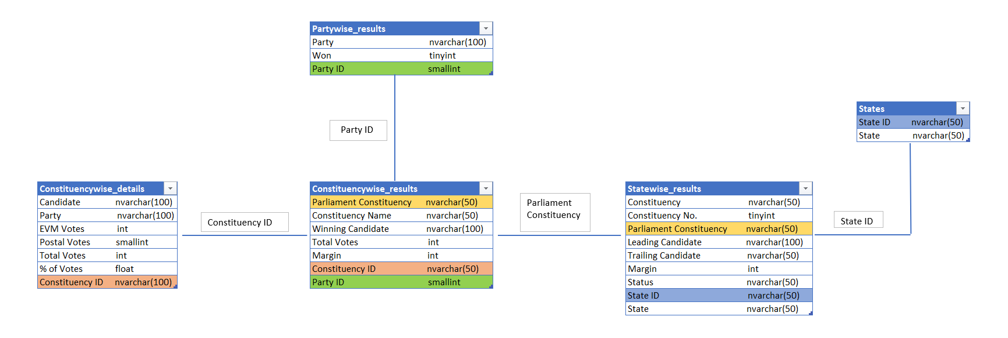
ERD – Entitiy Relationship Diagram

Slide 5
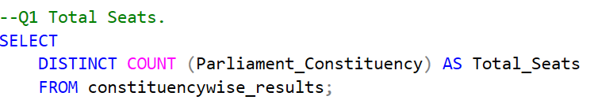


Slide 6
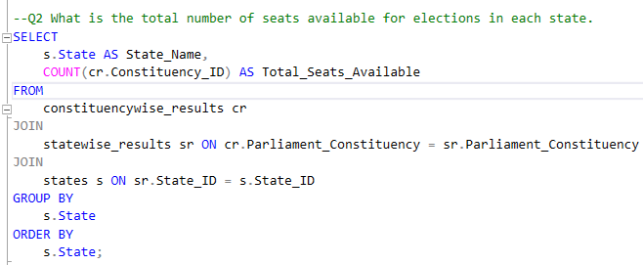
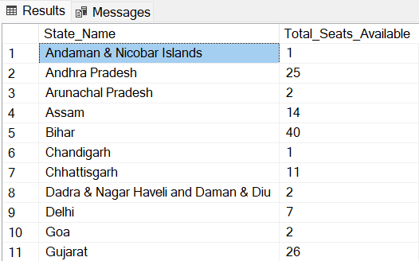
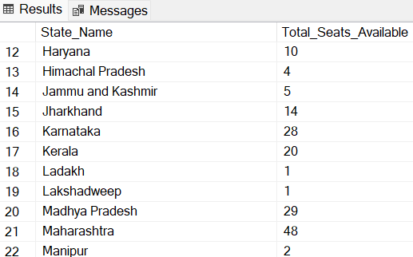
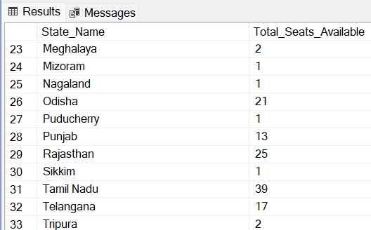

Slide 7
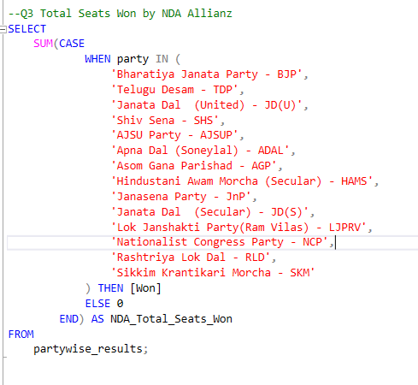
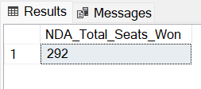

Slide 8
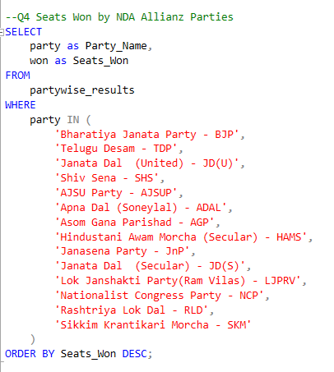
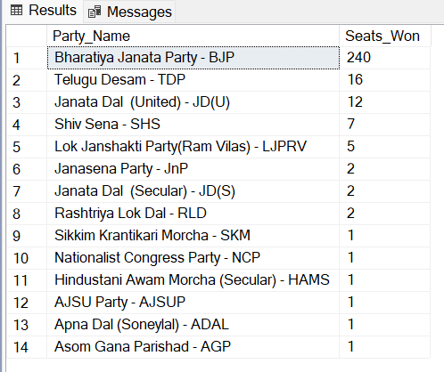

Slide 9
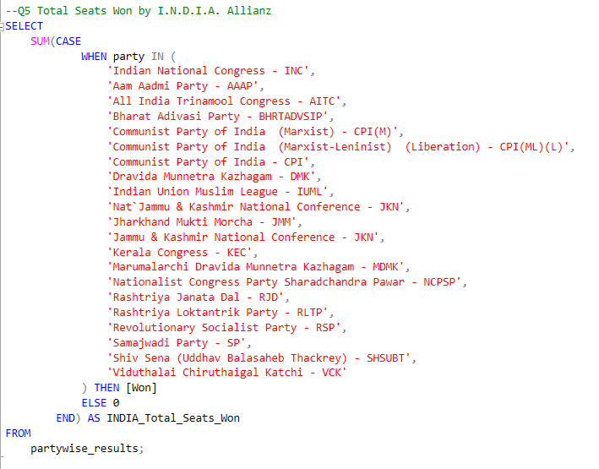
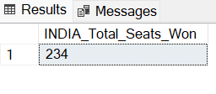

Slide 10
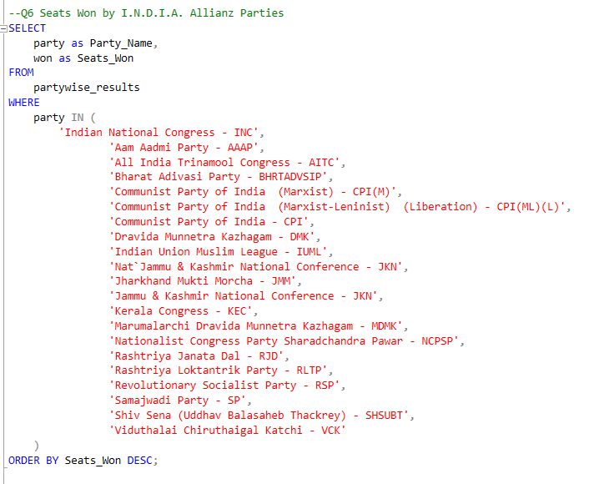
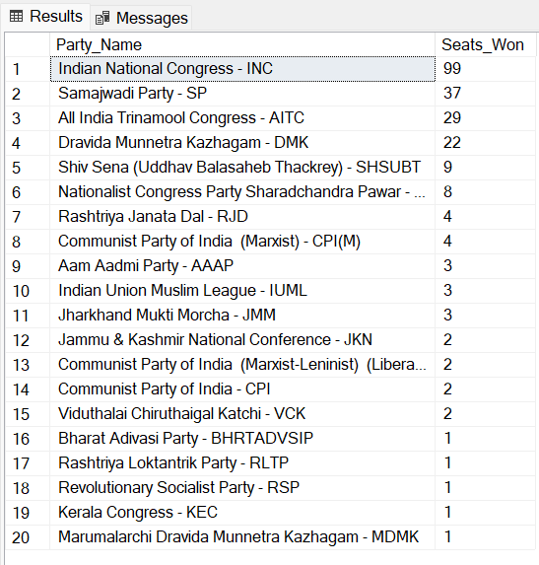

Slide 11
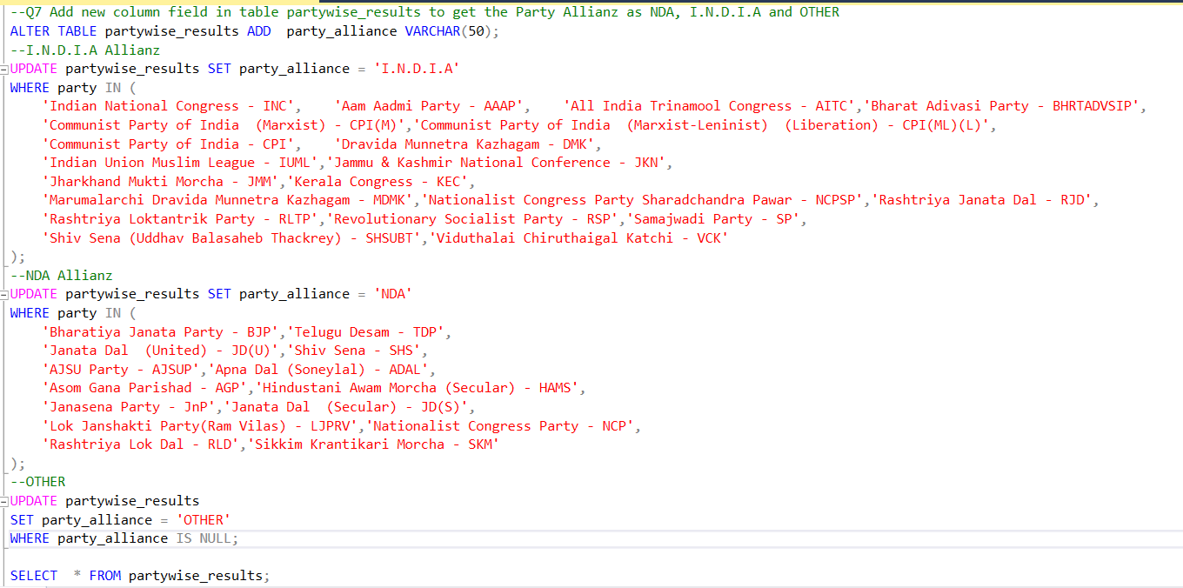
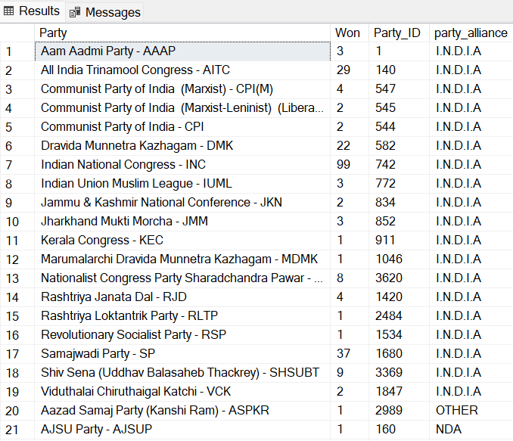
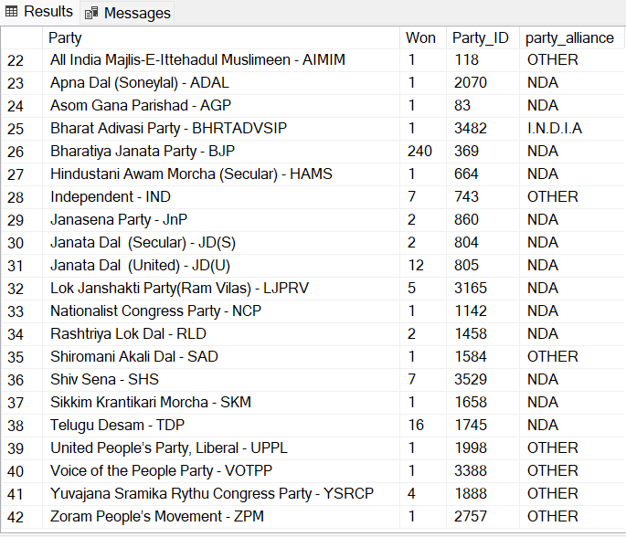

Slide 12
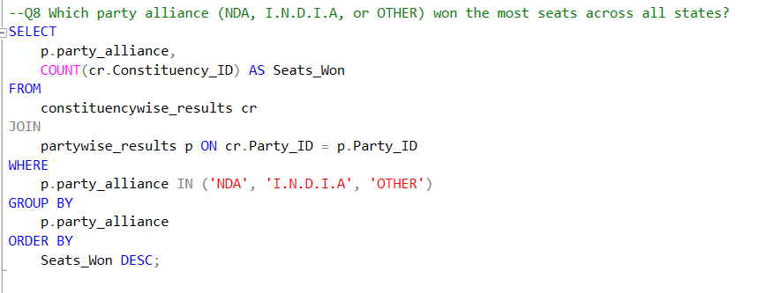
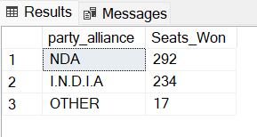

Slide 13
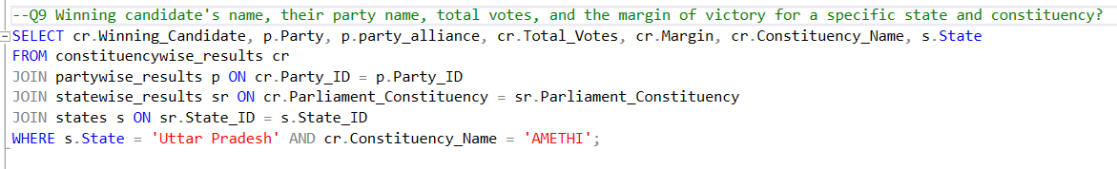
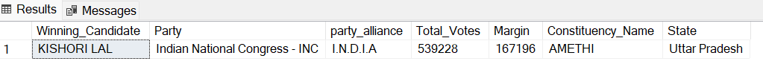

Slide 14
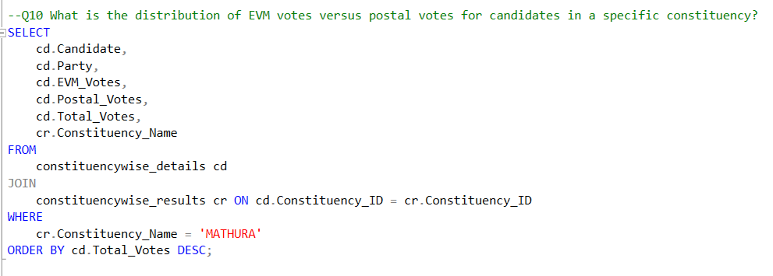
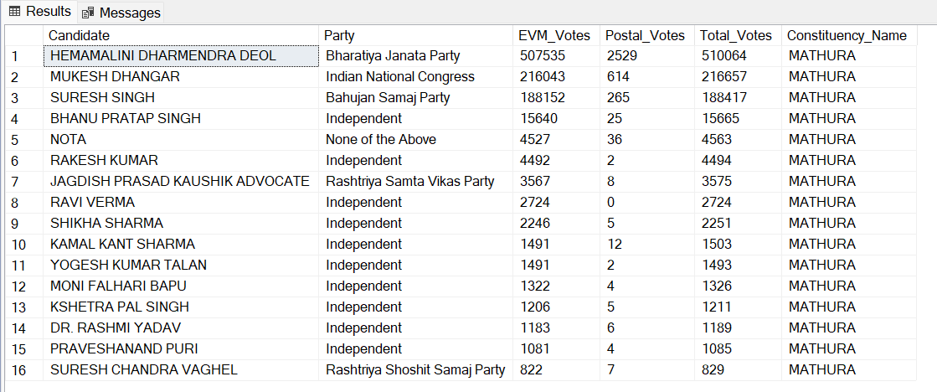

Slide 15
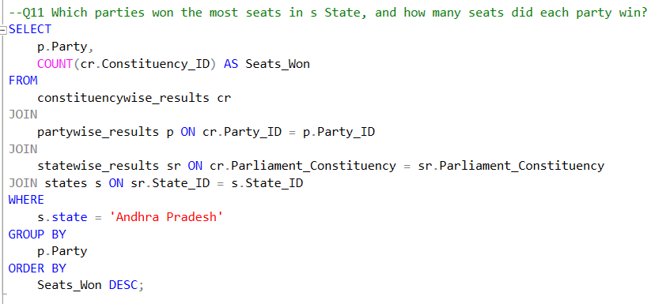
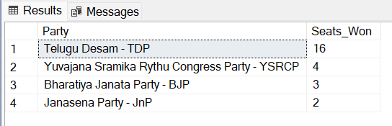

Slide 16
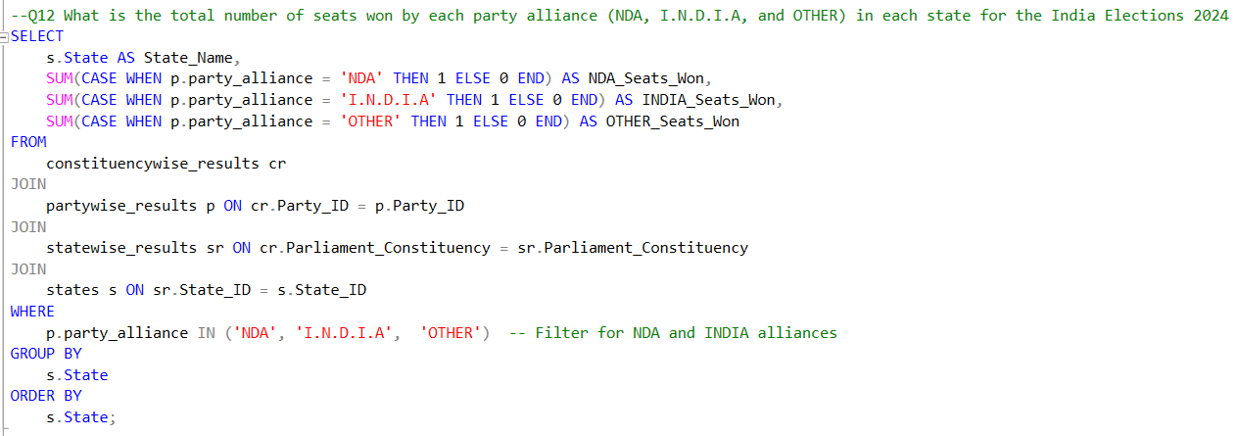
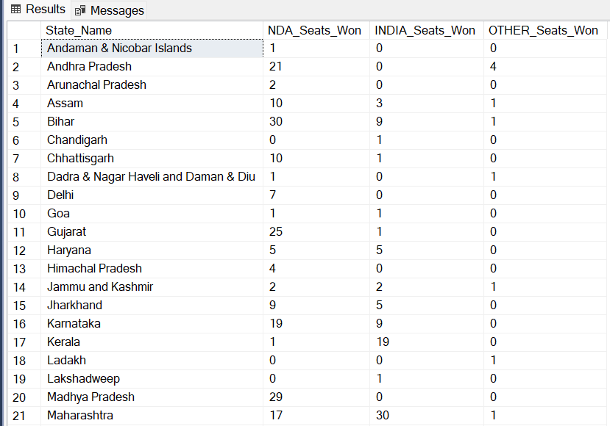
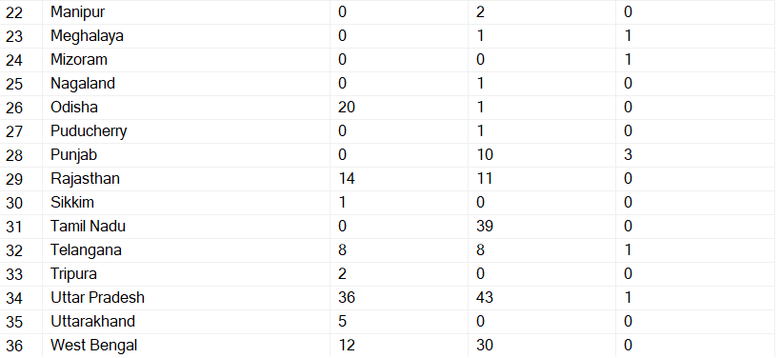

Slide 17
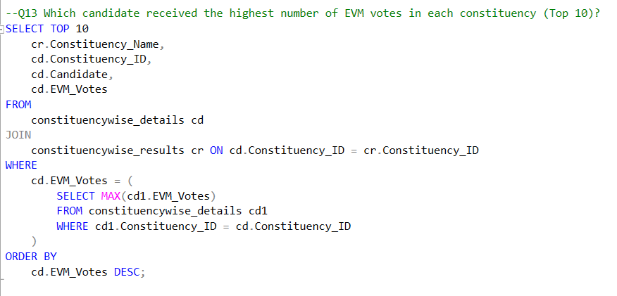
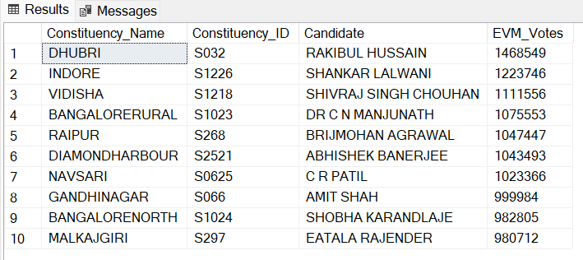

Slide 18
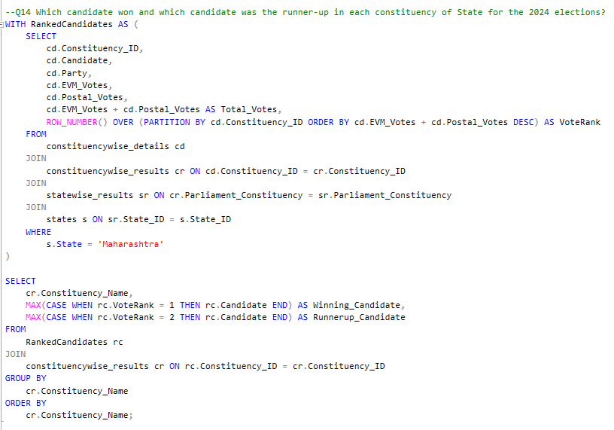

Slide 19
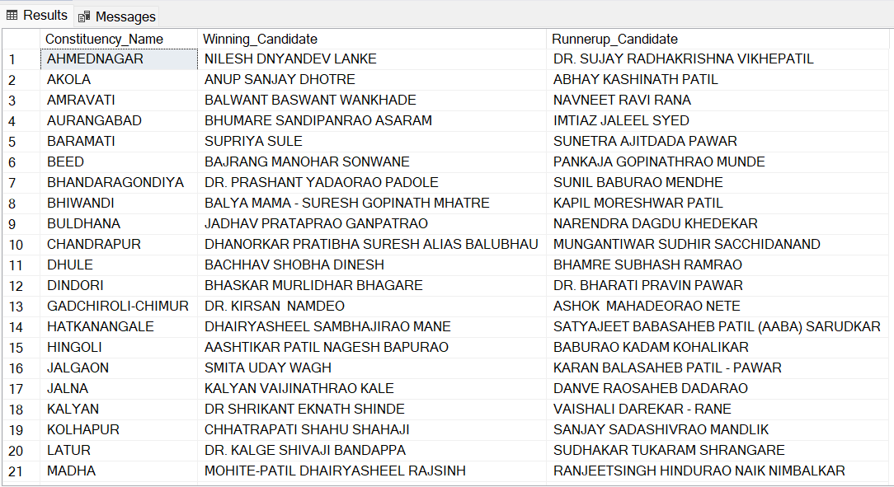
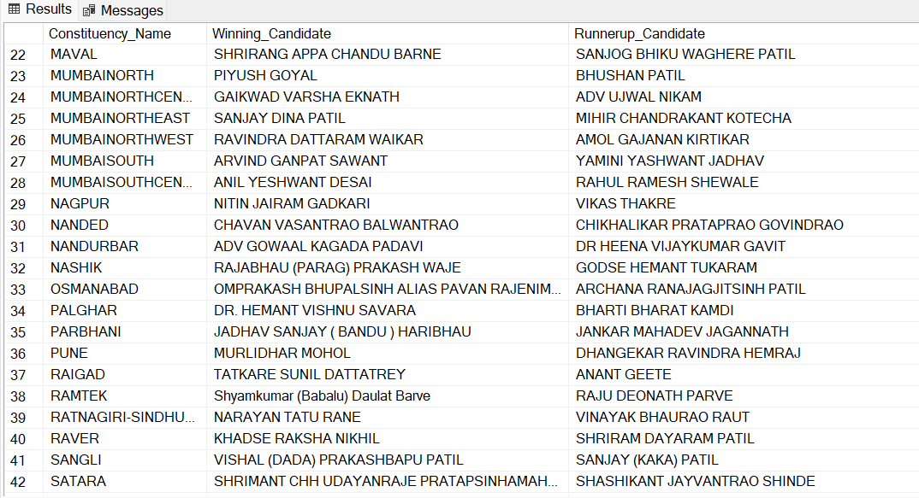

Slide 20
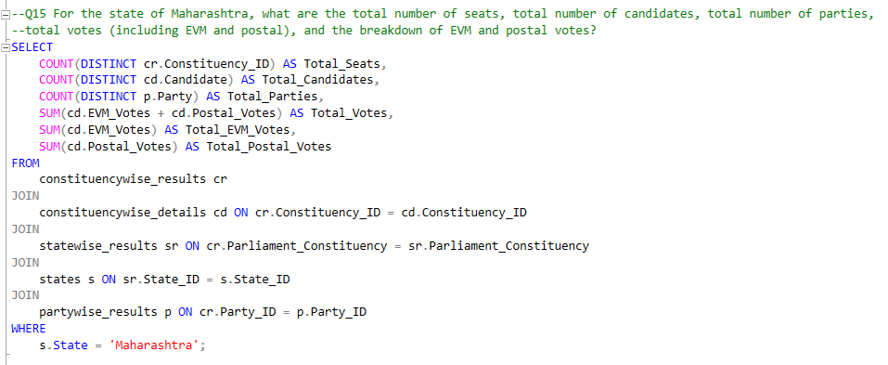
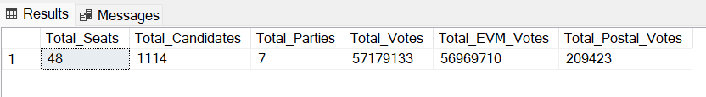

Slide 21


Q16.Create View
Q17.Show View

Slide 22
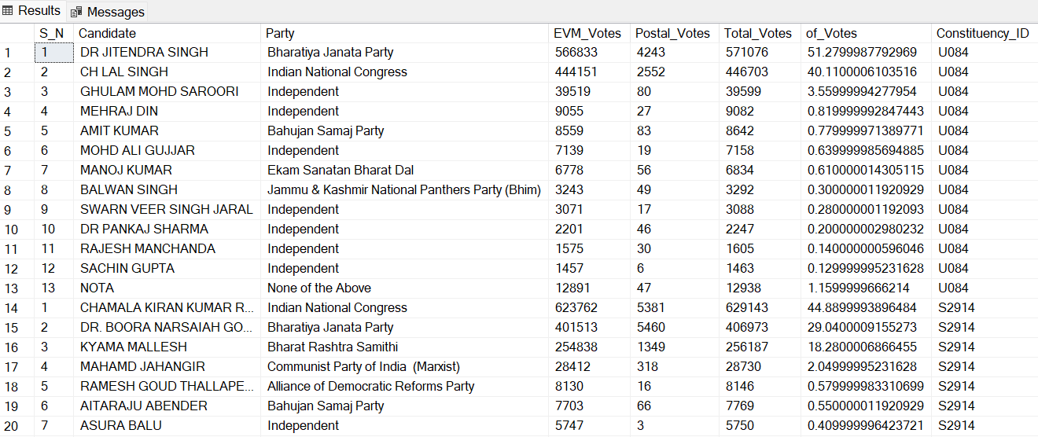
View Answer

Slide 23
Conclusion
Election result analysis is important for several key reasons:
Understanding Voter Behavior: It can reveal shifts in public opinion, voting patterns, and preferences that can inform future political strategies.
Policy Implications: A comprehensive analysis helps to assess how proposed policies may impact different sectors and communities.
Legitimacy and Transparency: Election result analysis is crucial for verifying that elections were fair, free from fraud.
Identifying Trends and Predictions: By examining past and current voting patterns, analysts can identify trends that may shape future elections.
5. Media Reporting and Public Discourse: Media outlets and public discussions rely heavily on election analysis to explain complex outcomes, making the process more accessible to voters and citizens

Slide 24

Thank you
Made By
Varadkar Astha Prashant Sakshi.

